Slide 1
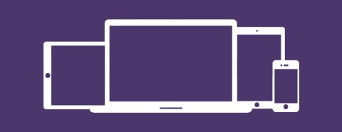
Web Design MCOSS2WED
Responsive Web Design

Slide 2
Mobile up design
Mobile devices represent a rapidly growing method of consuming Internet content:
Starting April 21 [2015], we will be expanding our use of mobile-friendliness as a ranking signal. This change will affect mobile searches in all languages worldwide and will have a significant impact in our search results. Consequently, users will find it easier to get relevant, high quality search results that are optimized for their devices.
Taken from: https://webmasters.googleblog.com/2015/02/finding-more-mobile-friendly-search.html [accessed 02/10/2016]

Slide 3
Bootstrap
Bootstrap is a CSS framework released by Twitter in 2011
It is open source – anyone can use it for free
It gives access to pre-defined CSS classes
It allows for a flexible grid system to be implemented
It promotes a mobile first/responsive web design approach
It’s not the only responsive framework but it is most popular

Slide 4
Bootstrap
Visit https://www.lyft.com/
Scroll through the site to get a feel for it.
Stop on the ‘How Lyft Works’ section.
What happens when you resize your browser in this section?

Slide 5
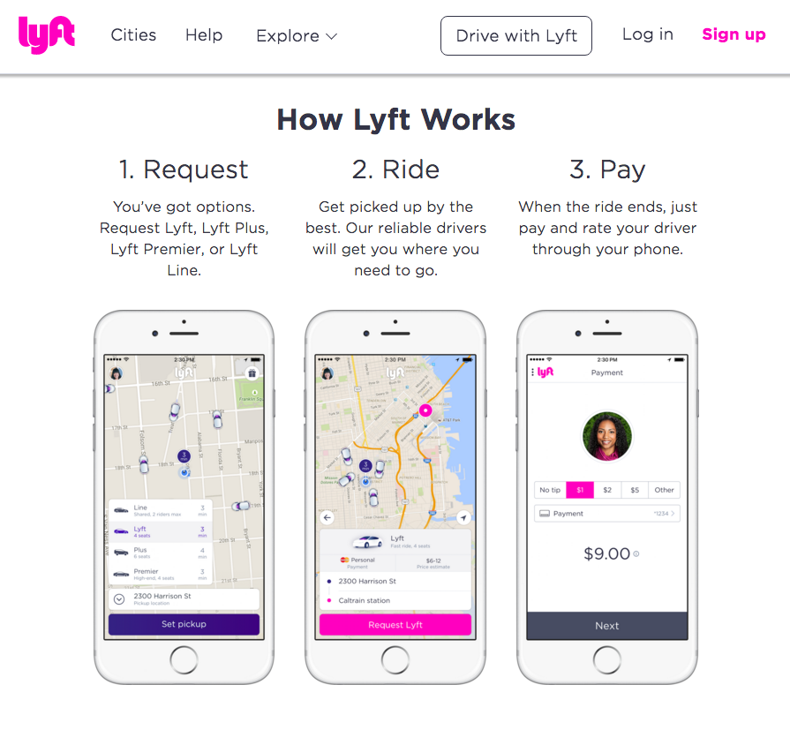
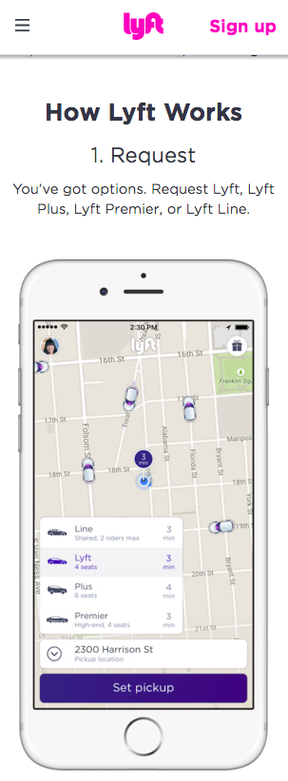
Menu collapses
Columns become stacked

Slide 6
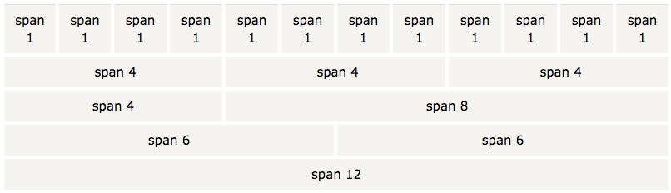
Grid system & div
Utilising Bootstrap, the page can be divided into a maximum of 12 columns
Each column can be 1 to 12 spans wide
Columns can also be set to “fluid”
Bootstrap grid image taken from: http://www.w3schools.com/bootstrap/bootstrap_grid_basic.asp [accessed 02/10/2016]

Slide 7
Grid system & div
Each row of columns exists in a <div class=‘row’>.
Each collection of rows resides in a <div class=‘container’>.
Each page can have multiple containers.
Containers can be nested.
Container
Row 1
Row 2
Row 3
Row 4
Row 5
Bootstrap grid image taken from: http://www.w3schools.com/bootstrap/bootstrap_grid_basic.asp [accessed 02/10/2016]

Slide 8
Grid system & div
See bs-example1.html.
Take a look at the way the divs are used to carve up the page into a grid structure.
One column span is roughly 1/12th of the relative browser width.

Slide 9
Breakpoints
Bootstrap defines four classes of browser widths:
XS (phones < 768px)
SM (tablets >= 768px)
MD (desktops >= 992px)
LG (large desktops >= 1200px)
XS is the default and does not always need to be specified – this promotes a mobile-up design ethic
Width in pixels can also be specified if needed
These viewport widths are called breakpoints

Slide 10
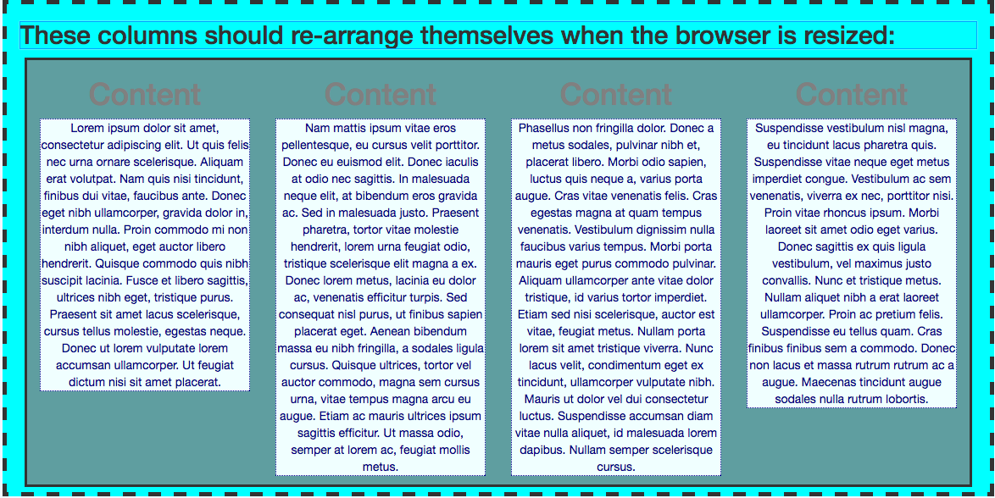
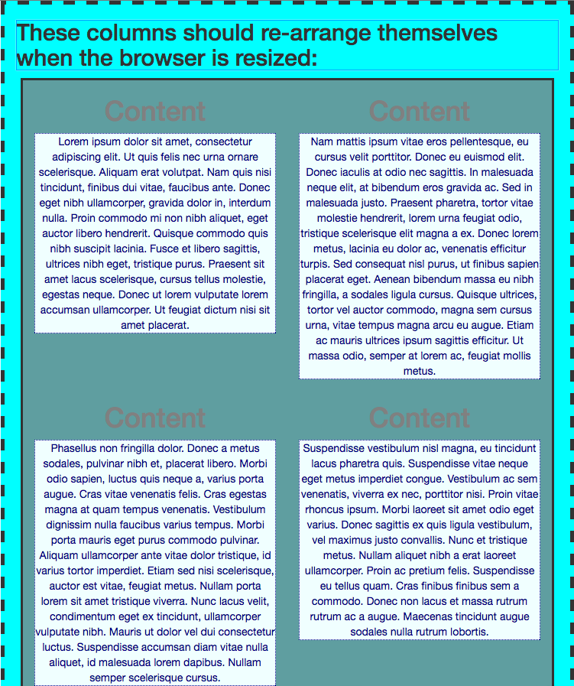
Responsive columns
Columns can automatically be re-arranged when pages are viewed at different widths (breakpoints):

Slide 11
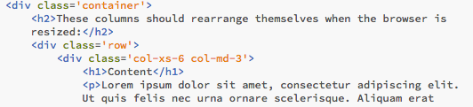
Responsive columns
This can be achieved using multiple classes for a column class:
See example bs-example1.1.html & .css

Slide 12
Media Queries
We can also adjust page content and layout using media queries.
Media queries are used in CSS to allow certain portions of code to be executed if logical conditions are met such as viewport width.

Slide 13
Media Queries
Elements can be shown and hidden depending upon media query tests.
Remember: to hide an element, use display: none is your CSS.
See bs-example2.html & .css

Slide 14
Media Queries
In bs-example2.css the following code hides the <h1> elements when the browser is resized below 800px.
@media (min-width: 800px){
h1 {
color: grey;
text-align: center;
display: block;
}
}

Slide 15
Media Queries
Here is another example. It uses media queries to hide whole div rows including the content depending upon the browser width.
See bs-example3.html & .css

Slide 16
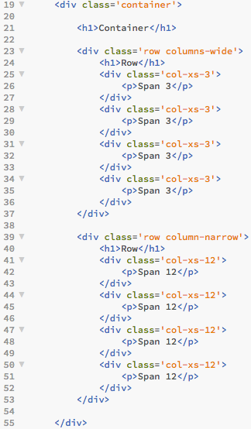
Example breakdown
There are two sections of HTML here divided into two rows.
The top one has a class of ‘columns-wide.’
The bottom one has a class ‘column-narrow.’

Slide 17
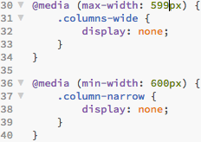
Example breakdown
Using media queries in CSS, these classes are hidden using display: none at specific viewport widths.
The ‘columns-wide’ class is hidden whilst the viewport width is below a maximum threshold of 599px.
The ‘column-narrow’ class is hidden whilst the viewport width is above a minimum threshold of 600px.

Slide 18
Example breakdown
Hiding the div class hides that entire section of HTML.
When this media query is true…
…this div class is hidden (because display: none becomes active)...
…leaving this div to be displayed.

Slide 19
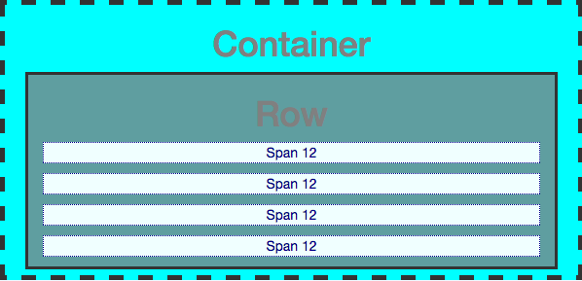
Example breakdown
Result:

Slide 20
Example breakdown
…leaving this div to be displayed as normal.
When this media query is true…
…this div class is hidden (because display: none becomes active)...

Slide 21
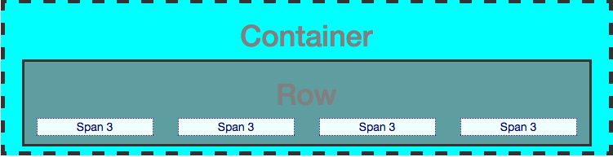
Example breakdown
Result:

Slide 22
Example breakdown
This allows us to change content and layout depending upon the viewport width.
This is especially useful if we want to hide a large element such as a graphic when it is viewed on a small mobile device.

Slide 23
Enabling Bootstrap
We can enable the Bootstrap framework in a couple of ways:
Download the framework (www.getbootstrap.com)
Or, link to an online repository in our HTML:

Slide 24
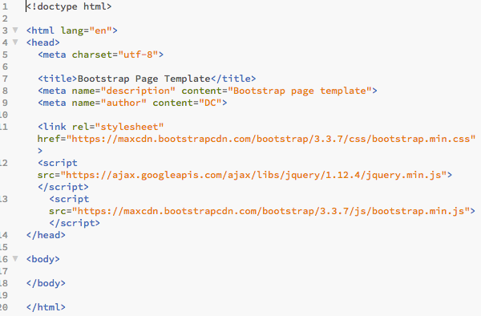
Enabling Bootstrap
Browse to www.iteachit.net/reference and download the Bootstrap page template.
The template already has links to a remote Bootstrap library to save us some time.

Slide 25
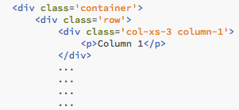
Challenge 1
Create a new Bootstrap HTML page using the template.
Create four div columns using a span of 3 for each.
Give each a unique colour using a new CSS file.
Add a paragraph in each saying ‘Column 1’ etc.
Here’s an HTML code snippet to get you started:

Slide 26
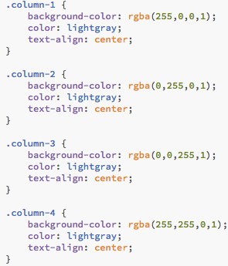
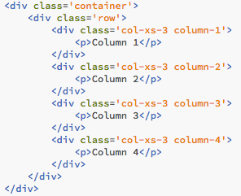
Challenge 1
CSS
My solution:
HTML

Slide 27
Challenge 1
Result (bs-challenge1.html):

Slide 28

Challenge 2
Change each column’s span so that:
Viewport XS = column span of 12
Viewport SM = column span of 6
MD and above = column span of 3
XS
SM
MD+

Slide 29
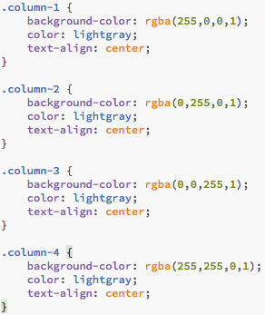
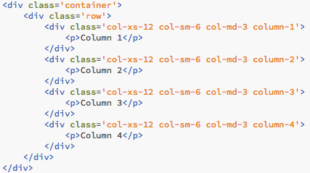
Challenge 2
My solution:
CSS (same as previous)
HTML

Slide 30
Challenge 2
Result – see bs-challenge2.html & .css

Slide 31
Challenge 3
Add some random text content in each column.
Change the font size progressively:
Viewport <= 600px – font size 8px
Viewport 601 to 800px – font size 14px
Viewport > 800 – font size 26px

Slide 32

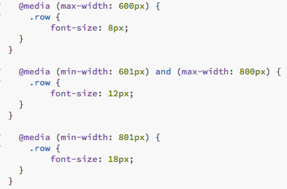
Challenge 3
My solution:
HTML (same as previous)
CSS (additional part only)

